Slide 1
Investigating Defects in REBCO Using DFT and Machine Learning Potentials
Supervisors: Rebecca Nicholls & Jonathan Yates

Slide 2
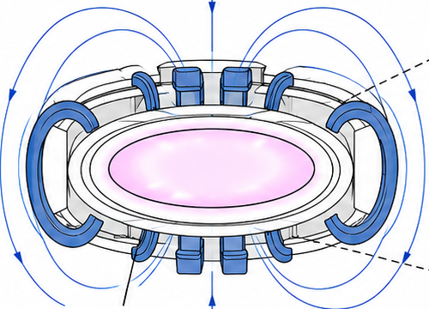
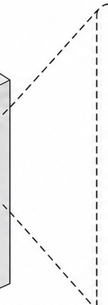
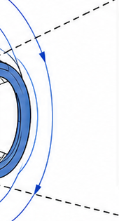
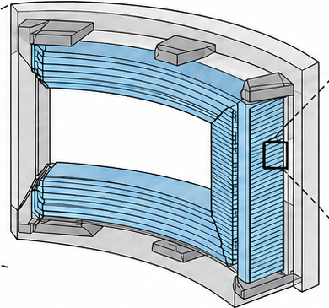
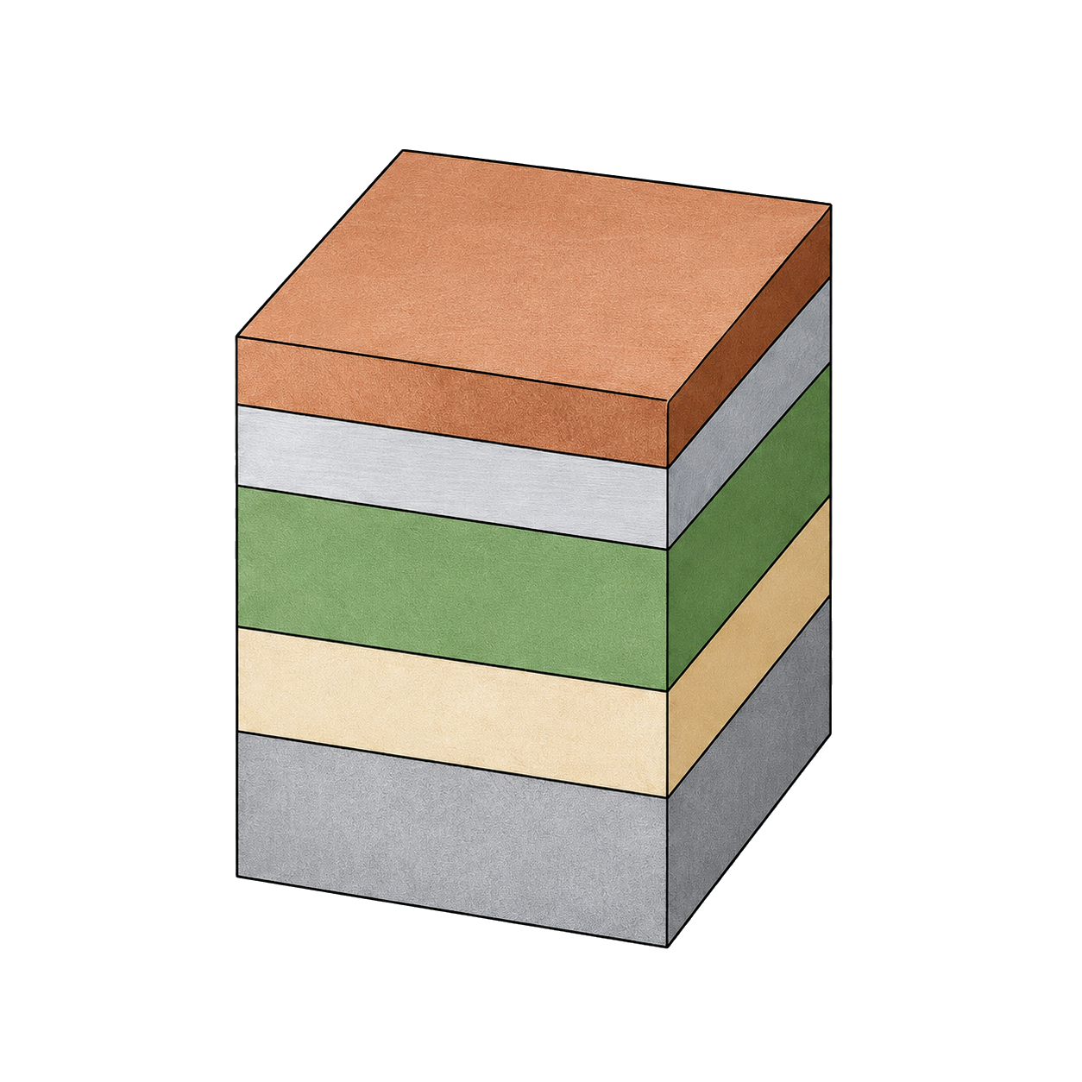
High magnetic fields in fusion magnets rely on REBCO superconductors
1. Fusion plasma requires
magnetic confinement
2. Strong magnetic fields are
generated by superconducting magnets
3. REBCO enables high-field
magnet operation
REBCO coated conductor tape
Copper stabilizer
Silver layer
REBCO
superconducting layer
Buffer layer
Substrate
Fusion plasma
Plasma must be confined by extremely strong magnetic fields. Requires high-performance superconducting magnets
Superconducting coils carry large currents with zero resistance. High critical current and field performance are essential.
REBCO coated conductors offer high critical current and high-field capability. Key enabler for next-generation fusion magnets
Notes:
High-temperature superconductors like REBCO are very important for next-generation fusion reactors, because they can generate the extremely strong magnetic fields needed to confine plasma.
The reactor will generate neutrons, but these neutrons will also damage the material in magnets and other materials in reactor, and REBCO is very sensitive to the damage.

Slide 3
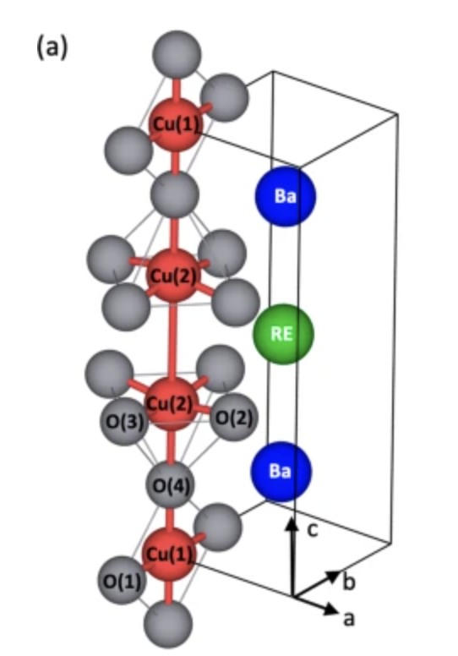
From irradiation damage to defect dynamics in REBCO
Neutron irradiation creates point defects
Part of the REBCO unit cell
Neutron impact
Fusion reactors generate high-energy neutrons. Neutrons can displace atoms from the REBCO lattice
Point defect formation
Irradiation can create vacancies and interstitials. A vacancy–interstitial pair forms a Frenkel defect
Why this matters
Defects can disturb the local structure. This may affect stability and superconducting performance
Notes:
Only need about 4 displacement per 1000 atoms in REBCO to drop critical temperature 10% down Which means there are many defects in the REBCO after irradiation, and irradiated REBCO can suffer significant degradation in superconducting performance.. Previous research have pointed out the defect type in irradiated REBCO , mainly O vacancy in Cu O plane, O interstitial, and Frankel defects, and how these defects affect the superconductivity of the material.
However, most of these studies are based on static observations, such as using microscopy to observe irradiated REBCO. We are also interested in the dynamic behaviour of these defects, for example how defects interact after they are formed, and whether vacancies and interstitials influence each other.

Slide 4
4
Why use MACE?
1. Method choice
DFT-MD
Empirical potentials
MACE
•
Accurate energies and forces
•
Fast and easy to use
•
Machine learning potential
•
High computational cost
•
Fixed analytic forms
•
Faster than DFT
•
Too slow for large defective REBCO
•
Limited flexibility for distorted structures
•
More flexible than empirical potentials
2. How MACE is trained
MACE represents each atom as a graph node and connects neighbouring atoms within a cutoff radius.
Equivariant message passing is used to learn the local atomic environment around each atom.
The model predicts atomic energies, which are summed to obtain the total energy, and forces are obtained from the energy gradient.
During training, MACE minimizes the difference between its predictions and DFT labels for energy, forces, and, when available, stress or virial.
Notes:
Therefore, we want to study REBCO using molecular dynamics (MD). However, DFT based MD is computationally very expensive. At every MD time step, the forces on all atoms must be recalculated using quantum-mechanical calculations. For a complex system like REBCO, especially when a large supercell is needed to model defects, the simulation becomes far too slow. By using ASE, it is much easier to run MD simulations. However, due to the complicated structure, conventional empirical potentials have limitations like Chaplot potential, it was developed for more ideal and regular crystal environments. In particular, after irradiation, REBCO shows significant extension along the c axis, and these traditional potentials often struggle to describe such large deformation. So ,we choose MACE. MACE is a machine learning potential, doesnt have an analytic expression, it works more like a black box, you give it a structure as input, it returns energy and forces. However, MACE is trained on conventional materials and regular crystals, Irradiated REBCO is much more complicated, we are not sure MACE is accurate or not.

Slide 5
Validation strategy for MACE
5
1. Benchmark structures
2. Optimise the same
structures with MACE
3. Compare with DFT
Pristine REBCO
Interstitial
Compare structural results
from DFT and MACE
Vacancy
Frenkel defect
ASE + MACE
Main metric: bond length
Geometry optimisation in DFT
to generate benchmark structures
Bond length reflects the local
atomic environment
Geometry optimisation
on the same set of structures
PBE functional used for consistency
with MACE training data
Sensitive to distortion
near defects
If MACE reproduces DFT bond lengths well, it can be used with more confidence for later MD simulations.
Notes:
So, the first task of my project is to validate the accuracy of MACE. I first performed geometry optimisation in DFT for both pristine REBCO and defective structures containing interstitials, vacancies, and Frenkel defects, in order to obtain a set benchmark data.
For the DFT calculations, I used the PBE functional, because the MACE was also trained on PBE DFT data.
I then used MACE within ASE to perform geometry optimisation on the same structures, and compared the resulting structural data with the DFT results. The main quantity I focused on was bond length, because it directly reflects the local atomic environment and is very sensitive to structural distortion near defects.

Slide 6
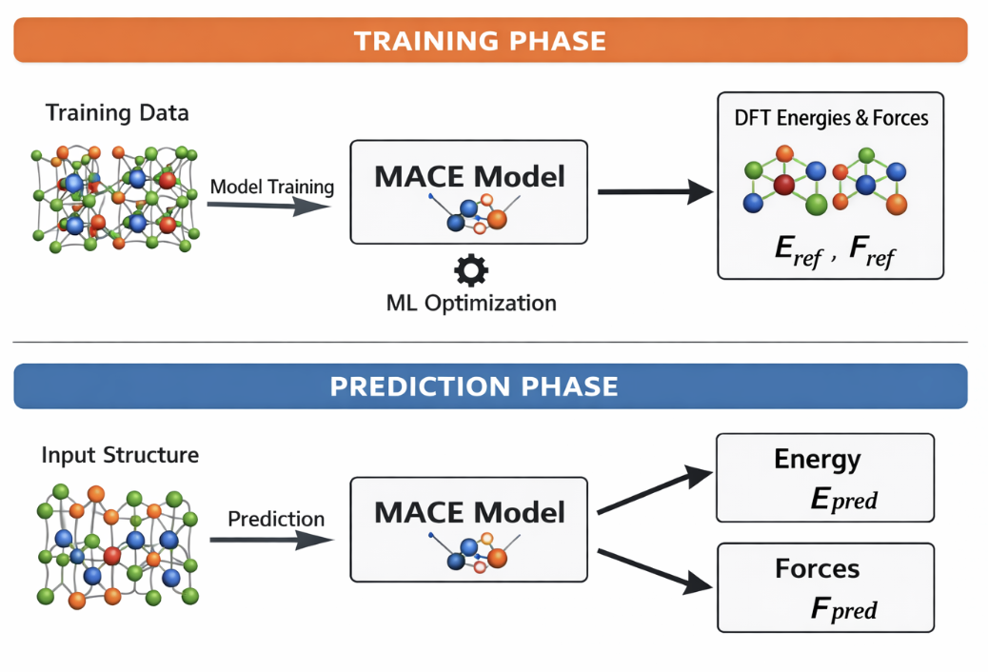
Machine learning potential
Notes:
Therefore, we want to study REBCO using molecular dynamics (MD) in order to understand the behaviour of irradiation-induced defects at the atomic scale.
However, although traditional DFT-based MD is highly accurate, it is also computationally very expensive. For a complex system like REBCO, especially when a large supercell is needed to model defects, the simulation becomes far too slow.
By using ASE, it is much easier to run MD simulations. However, due to the complicated structure, conventional empirical potentials have limitations like Chaplot potential, it was developed for more ideal and regular crystal environments. In particular, after irradiation, REBCO shows significant extension along the c axis, and these traditional potentials often struggle to describe such large deformation. So ,we choose MACE. MACE is a machine learning potential, doesnt have an analytic expression, it works more like a black box, you give it a structure as input, it returns energy and forces. However, MACE is trained on conventional materials and regular crystals, Irradiated REBCO is much more complicated, we are not sure MACE is accurate or not.

Slide 7
Validation strategy
Compare DFT and ASE + MACE for geometry optimisation.
Test both pristine and defective structures: interstitial, vacancy, and Frenkel defect.
Use bond length as the main structural metric, because it is sensitive to local distortion around defects.
Notes:
So, the first task of my project is to validate the accuracy of MACE. I first performed geometry optimisation in DFT for both pristine REBCO and defective structures containing interstitials, vacancies, and Frenkel defects, in order to obtain a set benchmark data.
For the DFT calculations, I used the PBE functional, because the MACE was also trained on PBE DFT data.
I then used MACE within ASE to perform geometry optimisation on the same structures, and compared the resulting structural data with the DFT results. The main quantity I focused on was bond length, because it directly reflects the local atomic environment and is very sensitive to structural distortion near defects.

Slide 8
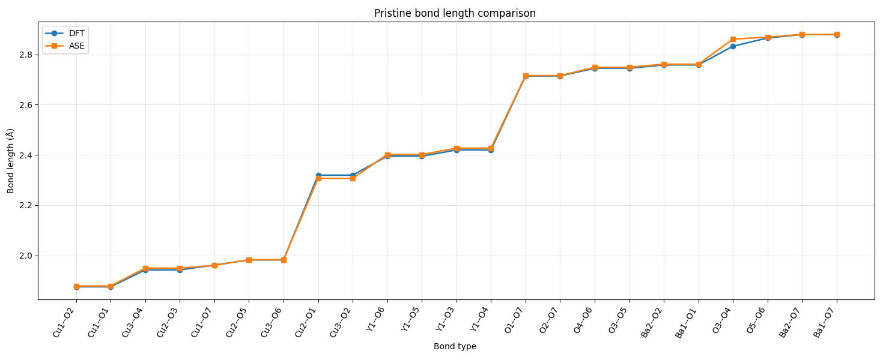
DFT vs MACE
Notes:
This figure shows the comparison of bond lengths between MACE and DFT for pristine Rebco
The orange line corresponds to MACE, and the blue line corresponds to DFT.
On the x-axis, I list different bond types, and on the y-axis is the bond length in angstrom.
As we can see, the two sets of data are in very close agreement across almost all bond types.

Slide 9
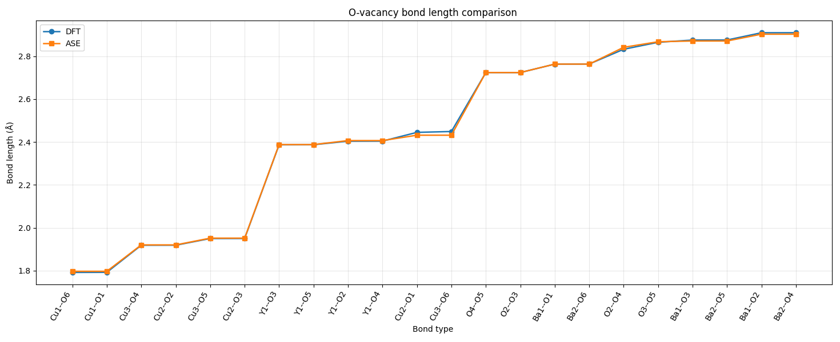
DFT vs MACE
Notes:
This figure shows the comparison of bond lengths between MACE and DFT for Oxygen vacancy defect.
The data sets are also very close.
This suggests that MACE can reproduce the local structure of REBCO very well,So this gives confidence that MACE is a reliable tool for modelling Rebco

Slide 10
MD set up
Target: stability of defects in irradiated REBCO
NVT ensemble at 298 K
Langevin thermostat for temperature control
Fixed-volume simulation of thermal equilibrium
5×5×3 supercell
Notes:
Since MACE shows very good agreement with DFT in terms of geometry-optimised bond lengths, I then used it for molecular dynamics simulations.
My research focuses on the stability of defects in irradiated REBCO.
After irradiation, the material loses its superconductivity and would be removed from the fusion reactor. So in the simulation, I used the NVT ensemble, where the number of particles, volume, and temperature are kept constant, with the temperature set to room temperature (298 K).
For temperature control, I used the Langevin thermostat.
This method maintains the system temperature by adding both damping and random forces to the equations of motion, while also mimicking the energy exchange between the lattice and a thermal bath.
For the structural model, I used a 5×5×3 REBCO supercell.
which provides a more realistic representation of low-concentration irradiation defects.

Slide 11
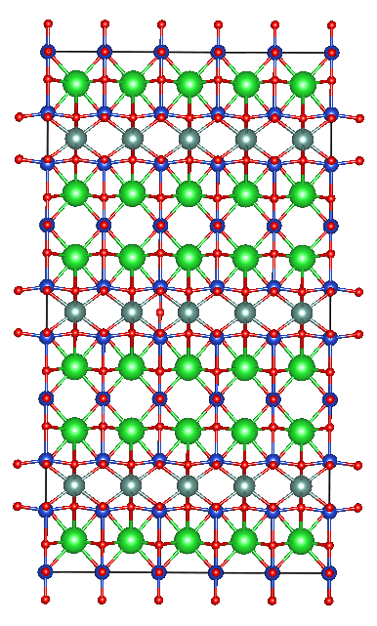
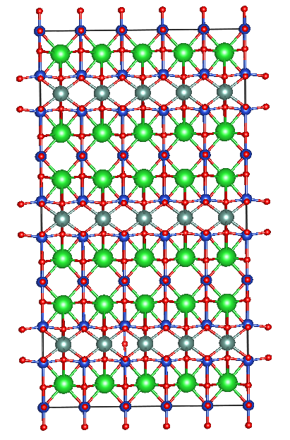
Frankel defects
Case 1: Oxygen Vacancy and Interstitial in same unit cell
Case 2:
Oxygen Vacancy and Interstitial in different unit cell

Slide 12
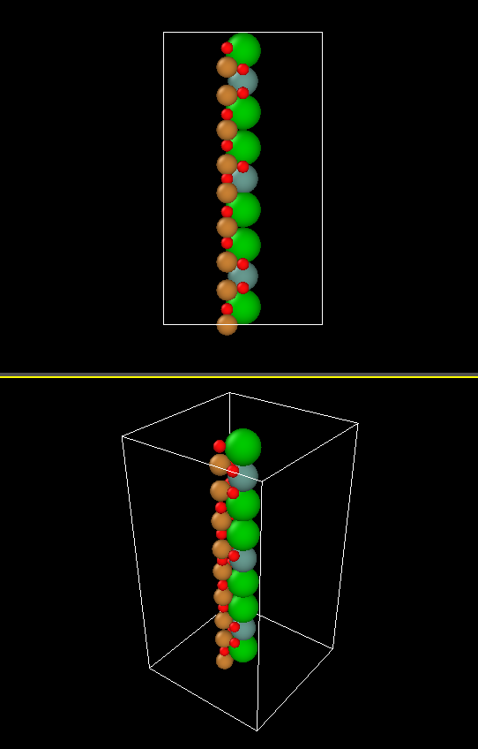
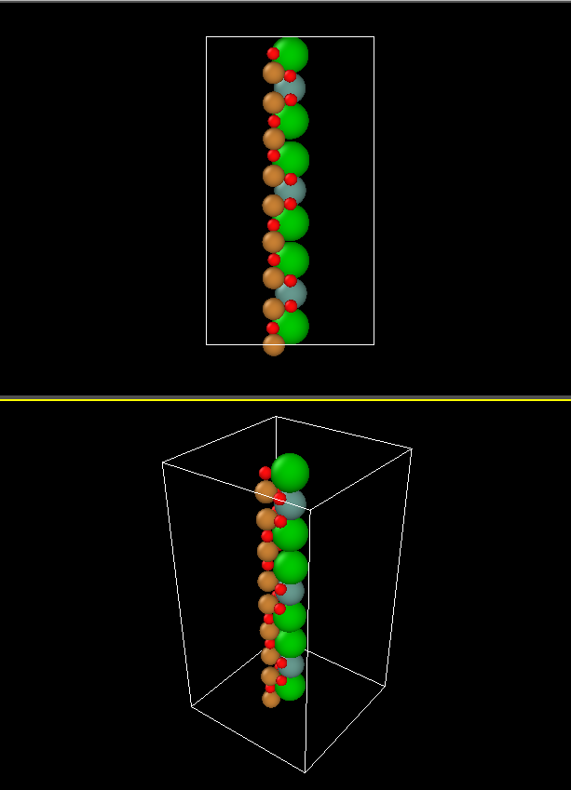
Case 1

Slide 13
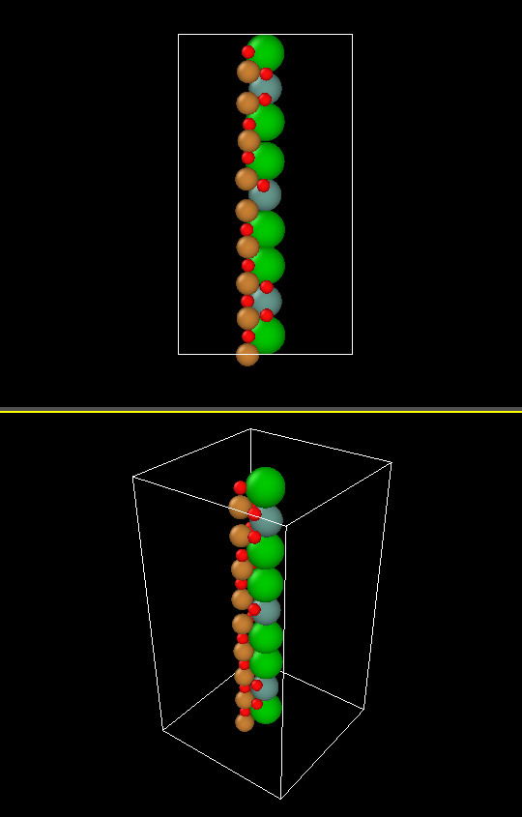
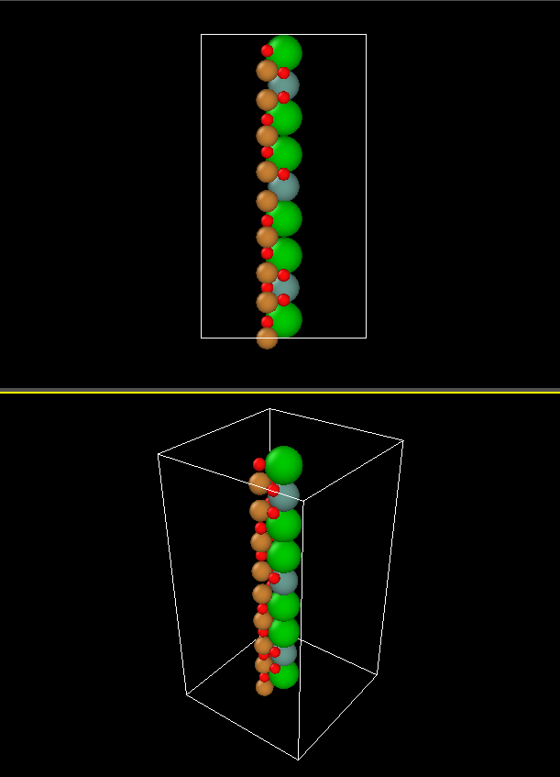
Case 2
Notes:
From the MD simulations we observe two different behaviours depending on the defect configuration.
In Case 1 the interstitial oxygen recombines with the vacancy during the simulation, while in Case 2 the Frenkel defect remains stable.
Beyond simply observing whether recombination occurs, we are also interested in how these defects influence the lattice dynamics of the material, including defect vibration, bond stiffness, disorder ect.
To analyse these effects, we calculate the velocity autocorrelation function (VACF) from the MD trajectories and obtain the vibrational density of states (VDOS) through Fourier transform.

Slide 14

Thermaldynamics & Knitics
Research Framework
1. Thermodynamics: Driving Force for Recombination
2. Kinetics: Ability to Overcome Energy Barriers
Evaluate whether recombination can occur by quantifying migration barriers and the recombination radius.
Evaluate whether recombination is thermodynamically favorable by calculating the Gibbs free energy change.
Minimum Energy Path (NEB Method):
Gibbs Free Energy Change:
Combine electronic energy, vibrational free energy, and configurational entropy to obtain Gibbs free energy.
1. Initial State (IS): separated Frenkel defect, optimized at 0 K, energy $E_{IS}$
2. Final State (FS): recombined perfect crystal, optimized at 0 K, energy $E_{FS}$
3. Interpolation: generate intermediate images between IS and FS
4. CI-NEB: find the transition state / saddle point (TS)
5. Activation Energy Barrier: $E_{α}$ = ETS − EIS
Δ$G_{f}$= $E_{defect}$ − $E_{pristine}$ − TΔ$S_{vib}$
• Edefect: total energy of the defective Frenkel system
• Eperfect: total energy of the perfect crystal
• ΔSvib: vibrational entropy difference from VDOS
• T: temperature (298 K in MD)

Slide 15
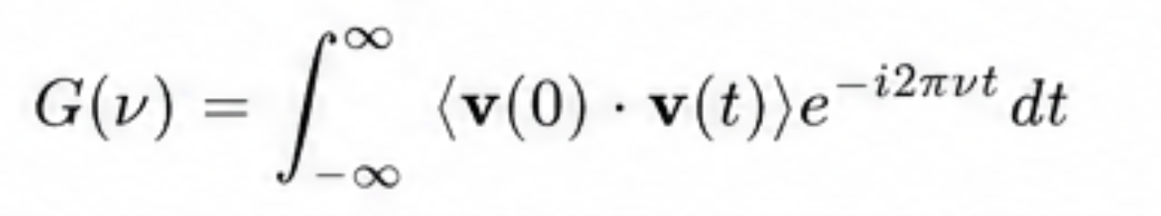

Thermodynamic Foundation: From VACF to Quantum-Corrected VDOS
Extract vibrational density of states (VDOS) from MD classical trajectories, and apply quantum correction to obtain physically meaningful thermodynamic quantities.
1. Physical Principle and Key Formulas
2. Workflow: From MD to Quantum-Corrected VDOS
•
From MD to VDOS
1. MD Trajectory (298 K):
Velocity Autocorrelation Function (VACF):
Perform classical MD simulation at 298 K to obtain atomic trajectories.
2. Compute VACF:
Calculate the velocity autocorrelation function from the MD trajectories.
VDOS is obtained from the Fourier transform of VACF.
•
Quantum Correction
3. Fourier Transform:
Apply Fourier transform to obtain the classical VDOS, gcl(ν).
(1) Dimensionless frequency variable:
x =$\frac{hv}{k_{B}T}$
4. Quantum Correction:
Compute the quantum weight function WS(ν) using x = hν/kBT.
where h is Planck constant, kB is Boltzmann constant, T is temperature.
5. Quantum-Corrected VDOS:
(2) Quantum weight function:
Obtain the quantum-corrected VDOS, gQ(ν) = gcl(ν) · WS(ν).
WS(ν) = x/(eˣ − 1) − ln(1 − e⁻ˣ)
Physical Meaning:
Quantum-Corrected VDOS:
gQ(ν) = gcl(ν) · WS(ν)
Quantum correction suppresses the unphysical overpopulation of high-frequency modes in classical MD, enabling accurate thermodynamic calculations.

Slide 16

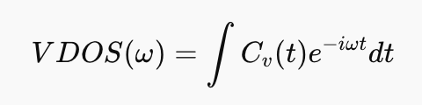
VACF & Vdos
Velocity autocorrelation function
Definition: Measures how atomic velocity correlates with itself over time, describes atomic vibrational dynamics
Vibrational density od state
Obtained from Fourier Transform of VACF
Definition; Represent the distribution of vibrational frequencies in the system
Notes:
a little bit equations for VDOS and VACF.
The velocity autocorrelation function, or VACF, measures how the velocity of atoms correlates with itself over time.
Mathematically, it is defined as the average dot product between the velocity at time zero and the velocity at a later time.
Physically, VACF describes how atomic motion evolves in time and therefore reflects the vibrational dynamics of the system.
From the VACF, we can obtain the vibrational density of states by performing a Fourier transform.

Slide 17
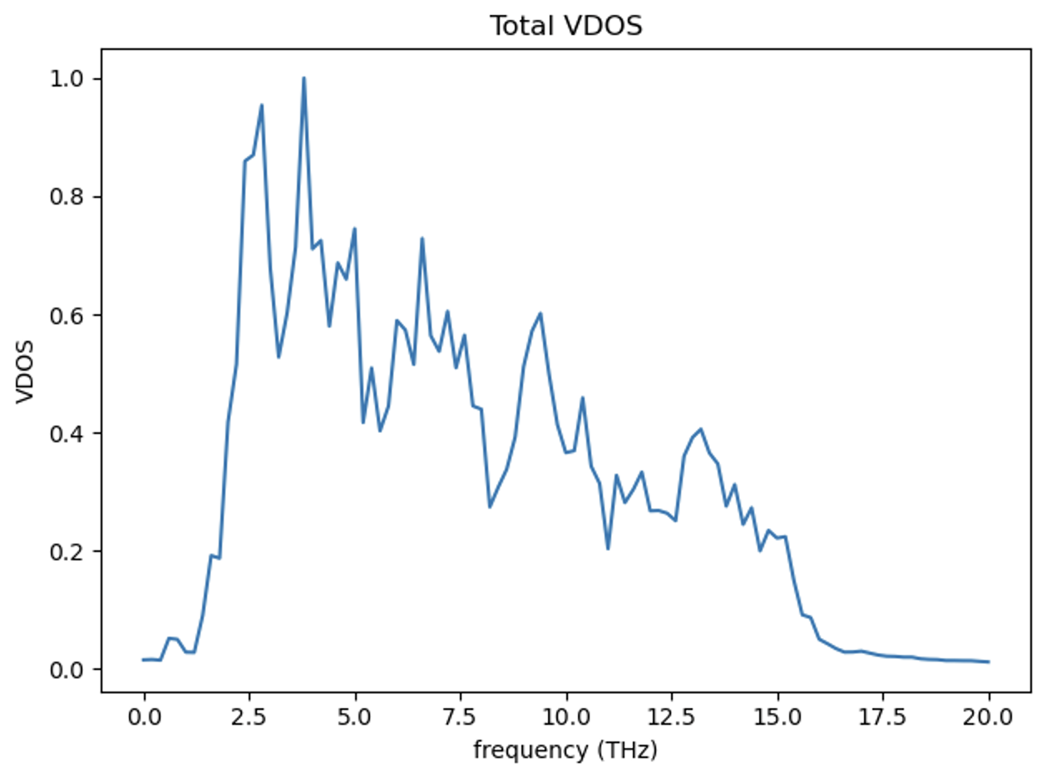
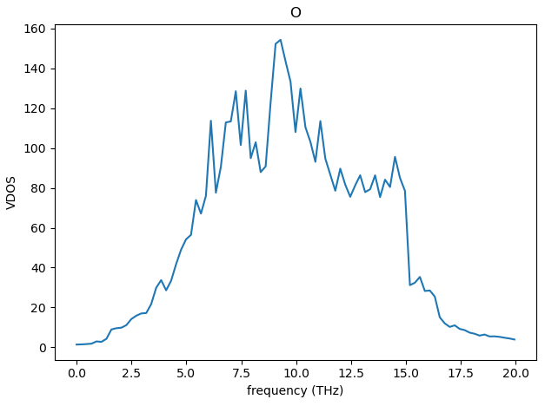
Vdos for case 2
Notes:
During the MD simulation, the vacancy and interstitial remain separated, and the overall lattice structure remains relatively stable.
First, looking at the total VDOS, the main vibrational intensity is between approximately 5 and 10 THz, with the strongest peak around 8 to 9 THz.
Next, we examine the element-resolved VDOS.
For oxygen, the spectrum closely follows the total VDOS, indicating that oxygen atoms dominate the vibrational behaviour of the system.

Slide 18
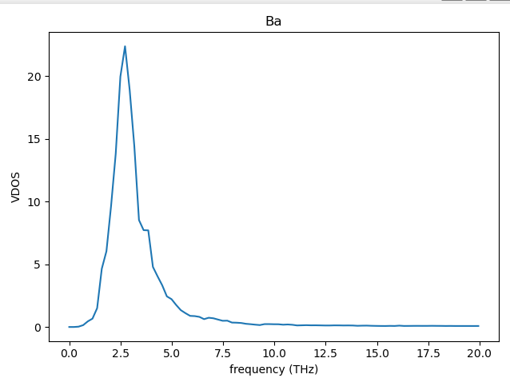
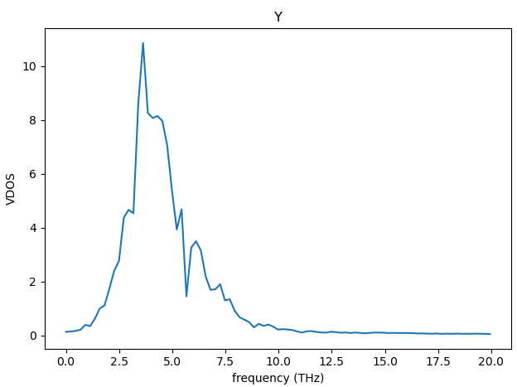
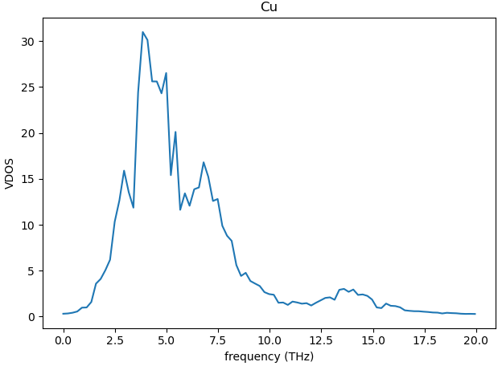
Vdos for case 2
Notes:
For barium and yttrium, the peaks are mainly located in the low-frequency region, around 3 to 5 THz. This is dur to their larger atomic masses, which lead to lower vibrational frequencies.
For copper, the main contribution appears in the intermediate frequency range, roughly between 4 and 8 THz, with a small contribution extending into higher frequencies.
Overall, the absence of any sharp abnormal peaks suggests that the Frenkel defect does not introduce strong lattice instability in this configuration, although it still perturbs the local vibrational environment.

Slide 19
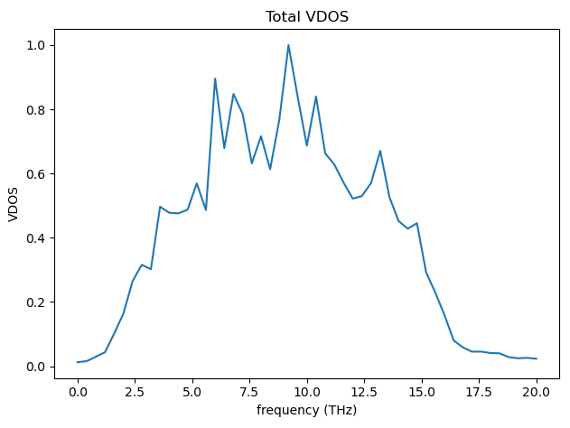
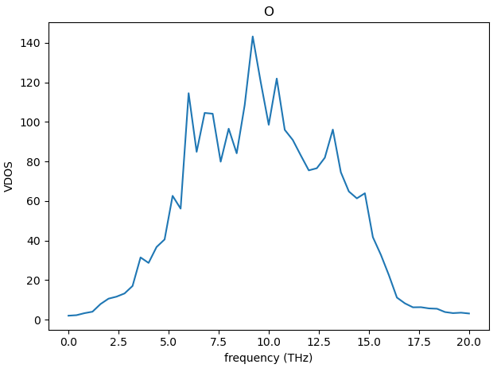
Vdos for case 1

Slide 20
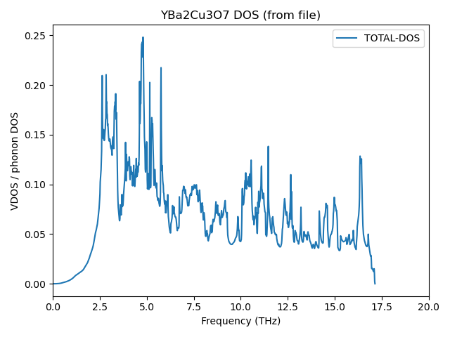
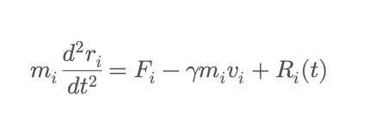
Perturbation graph

Slide 21
